Slide 1
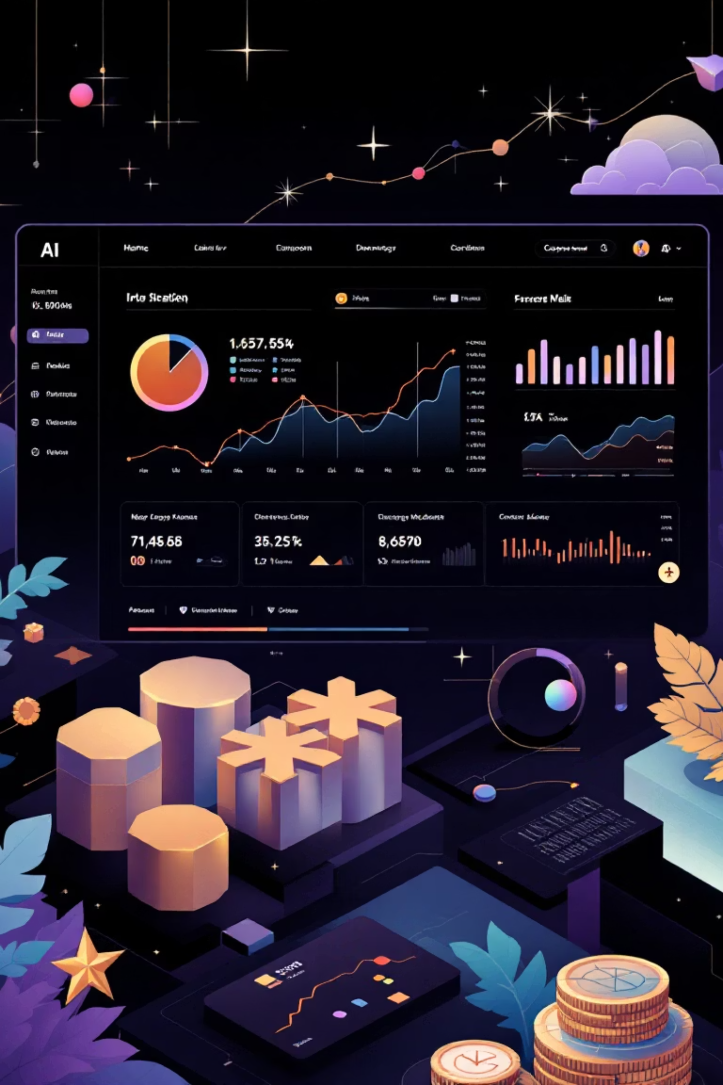
My Progress Report: AI Financial Advisor Project
WealthWhiz – Intelligent Personal Finance Management

Slide 2




Project Roadmap: From Concept to Implementation
Vision
Technology Stack
AI-driven personalised financial advisor delivering intelligent insights
Full MERN Stack integrated with Django backend for robust performance
Key Features
Timeline
Historical analysis, predictive modelling, real-time suggestions, personalised dashboards
3-month development cycle from planning to production deployment

Slide 3
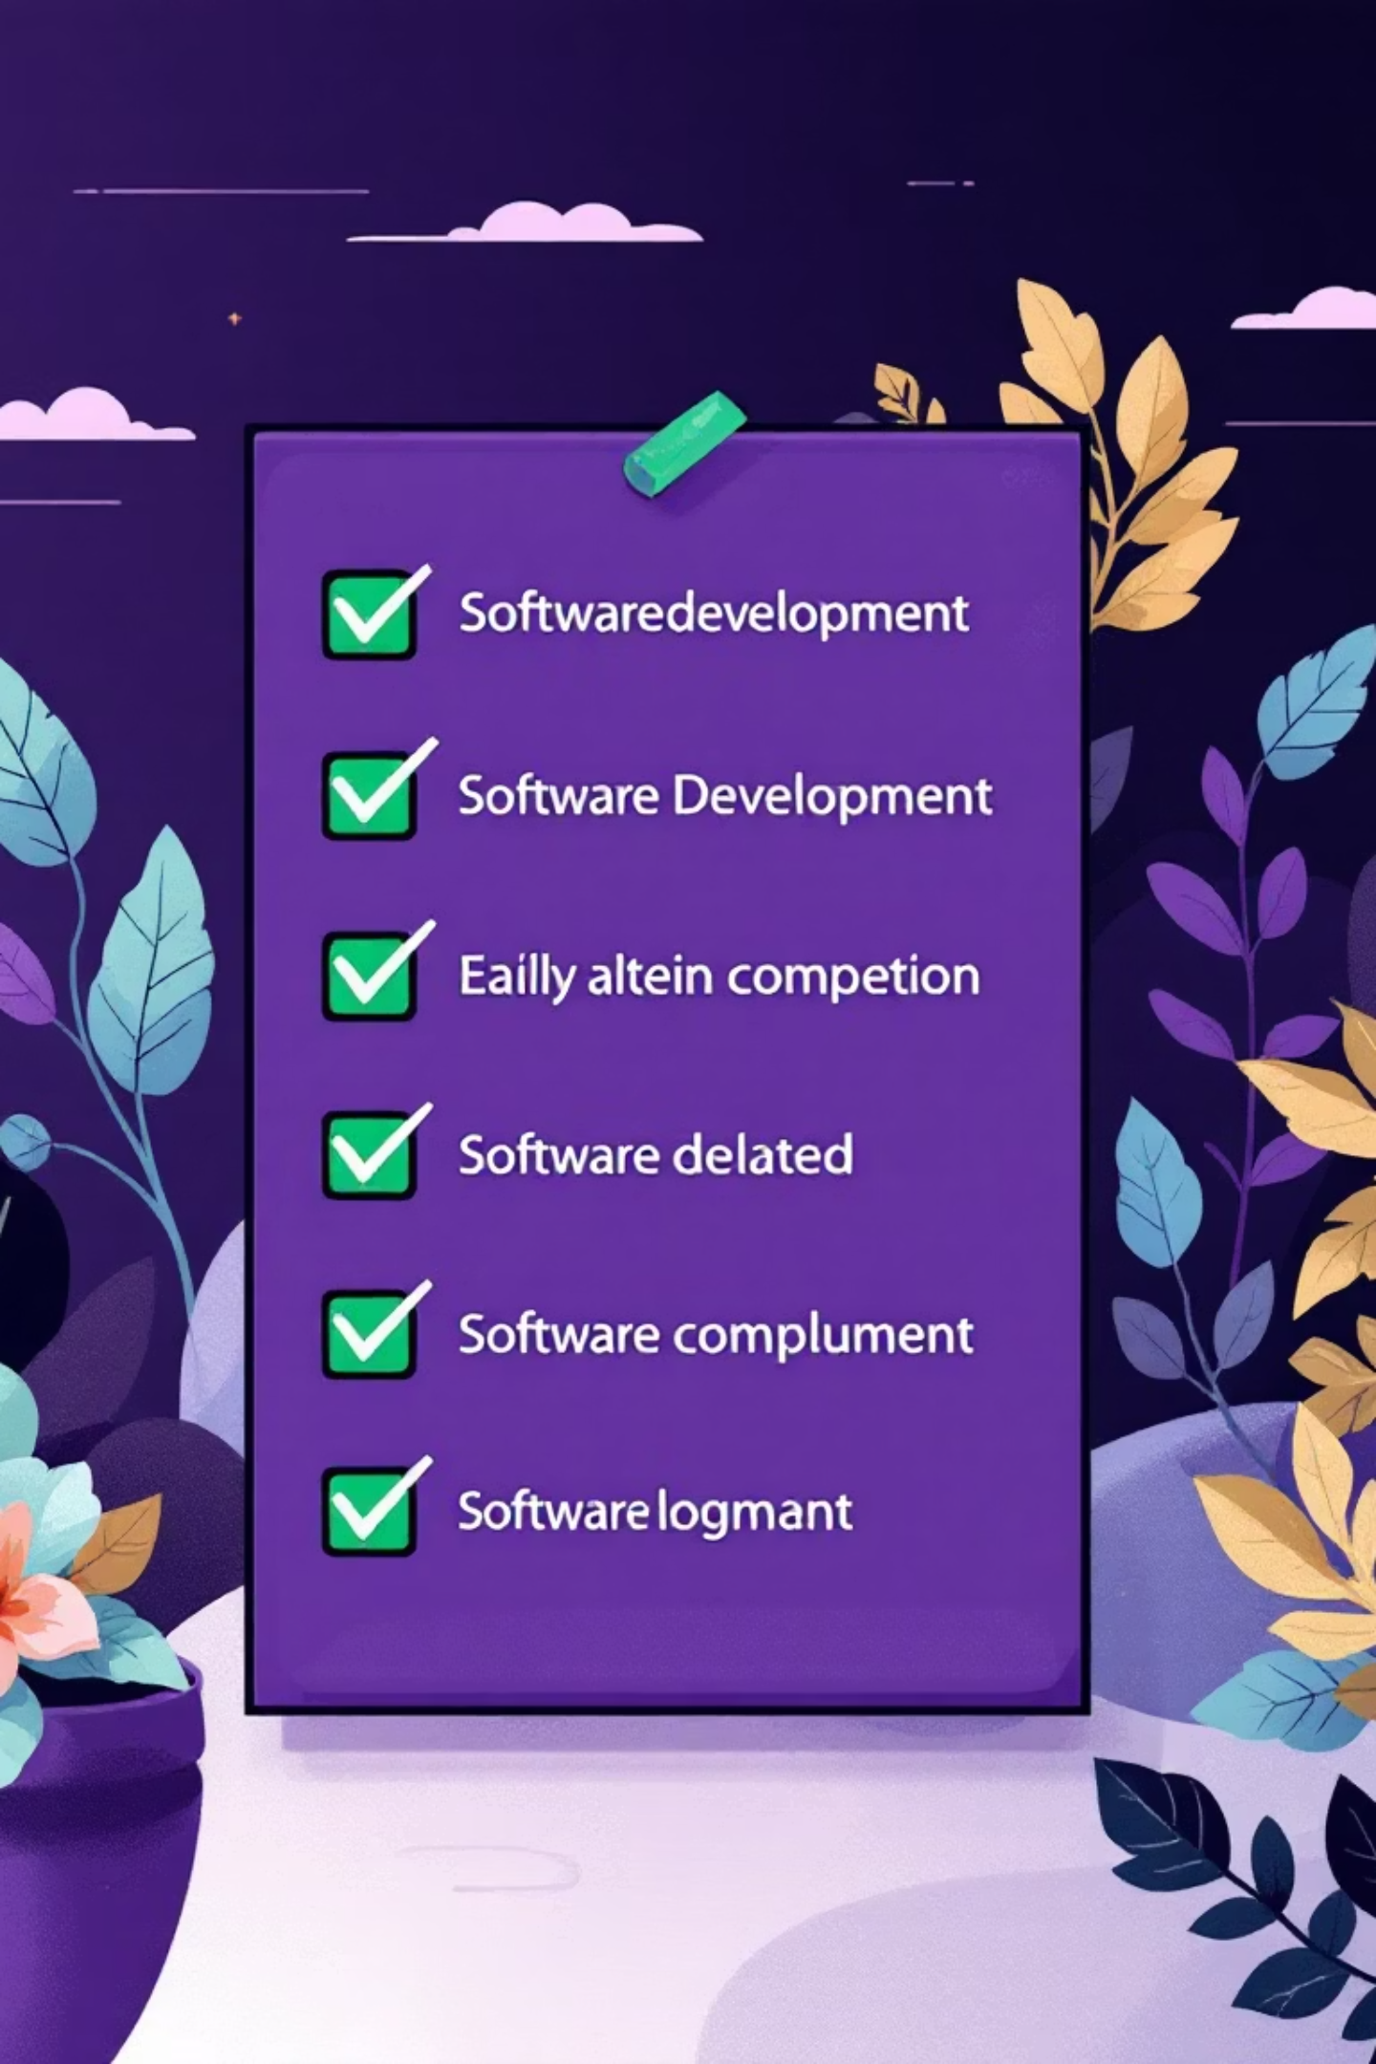
Completed Milestones
Backend Development
Frontend Development
Django REST Framework implementation complete
React.js dashboard with real-time updates
PostgreSQL database with 5+ years historical data
Interactive data visualisation via Chart.js
AI model integration using TensorFlow/PyTorch
Responsive UI/UX design with Tailwind CSS
Secure JWT/Knox authentication system
Seamless user authentication flow
RESTful API endpoints deployed
Complete API integration achieved

Slide 4

System Design & Infrastructure
External APIs
Market data and news feed
User Devices
Web and mobile access
PostgreSQL
10-year data and analytics
Django API
REST APIs and AI models
React Frontend
Dashboard and real-time UI
Our architecture ensures scalability, security, and real-time performance across all system components. The microservices approach enables independent scaling of frontend, API, and data layers whilst maintaining seamless integration.

Slide 5





Intelligent Financial Analysis Engine
01
Data Collection
Aggregating 10+ years of comprehensive historical financial data from multiple verified sources
02
Preprocessing
Cleaning, normalisation, and sophisticated feature engineering to ensure data quality
03
Analysis
Time-series analysis and advanced pattern recognition using machine learning algorithms
04
Prediction
LSTM and Random Forest models delivering accurate forecasts and actionable insights
Market Trend Analysis
Real-time identification of emerging market patterns
Risk Assessment Engine
Sophisticated algorithms evaluating investment risks
Personalised Recommendations
Tailored financial strategies based on individual goals
Future Value Prediction
Accurate forecasting of portfolio performance

Slide 6
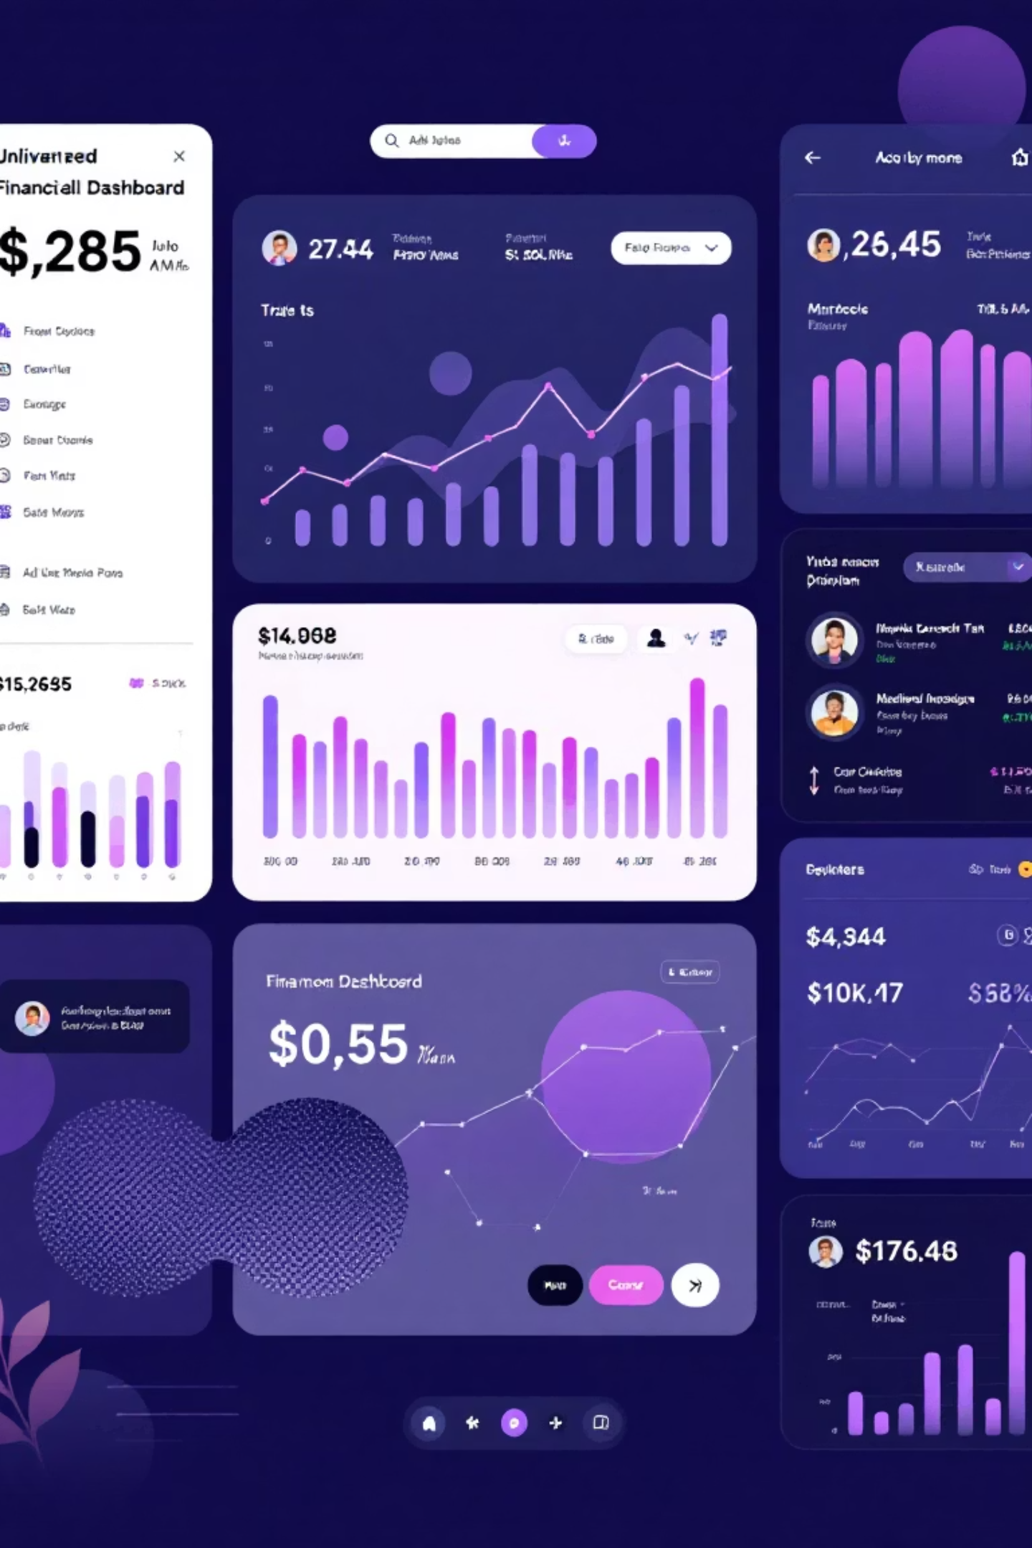
Modern User Interface
Core Features Built
Technology Stack
Net Worth Tracker: Real-time wealth monitoring
React.js with modern Hooks architecture
Expense Analytics: Intelligent spending insights
Tailwind CSS for responsive styling
Investment Portfolio: Comprehensive asset management
Chart.js for dynamic data visualisation
React Router for seamless navigation
Goal Progress: Visual achievement tracking
Axios for efficient API integration
AI Recommendations: Smart financial guidance

Slide 7




Technical Competencies Developed
Backend Development
Frontend Development
Django REST Framework: Advanced API development and optimization
React.js: Component-based architecture mastery
PostgreSQL: Schema design and query optimisation
Tailwind CSS: Utility-first responsive design
Security: JWT authentication and data encryption
Data Visualisation: Interactive Chart.js implementation
AI Integration: TensorFlow/PyTorch model deployment
State Management: React Hooks & Context API
DevOps & Deployment
Docker: Containerisation and orchestration
Cloud Deployment: AWS/Heroku production environments
CI/CD: Automated deployment pipelines
Testing: Comprehensive unit & integration testing

Slide 8




Challenges Overcome
Data Quality Issues
AI Model Accuracy
Solution: Implemented robust validation pipeline
Solution: Ensemble learning with hyperparameter tuning
Outcome: 99.8% clean data achieved
Outcome: 92% prediction accuracy
Real-time Updates
Performance Optimization
Solution: WebSocket implementation
Solution: Database indexing plus caching
Outcome: <1s update latency
Outcome: 3× faster response
Each technical challenge strengthened the system's reliability and performance whilst deepening our understanding of production-grade development practices.

Slide 9



Quantifiable Results
15K+
85%
200ms
10GB+
Lines of Code
Test Coverage
API Response
Historical Data
Full-stack development effort
Comprehensive unit testing
Average response time
Financial records stored
99.9%
98.5%
100%
System Uptime
Data Accuracy
Security
Reliable production performance
Validated information quality
Authentication protocols

Slide 10

Looking Ahead: Next Steps & Future Vision
1
Short-term Goals (Next 3 Months)
Mobile application development with React Native
Enhanced AI models with deep learning integration
Real-time market data via WebSocket streaming
Multi-user support for family and team accounts
Advanced security features including 2FA and biometrics
2
Long-term Vision (Next 12 Months)
Global market support for international investments
API marketplace enabling third-party integrations
Native iOS and Android mobile-first experience
Bank integration leveraging Open Banking APIs
Financial education platform with learning resources
WealthWhiz represents more than a technical achievement—it's a platform positioned to transform how individuals manage their financial futures through intelligent, personalised guidance.

